Slide 1




Project - 4
Plant Disease Detection System for Sustainable Agriculture
​

Slide 2
About Project
Develop a CNN-based model capable of detecting and classifying plant diseases from images of leaves of various crops such as apple, cherry, grape, and corn. The model should accurately identify both healthy and diseased leaves while predicting the specific type of disease. This system will aid in precision agriculture by enabling early detection and effective disease management
Key Steps:
Data acquisition and Data Augmentation
Building CNN model
Model Training, Optimization and Evaluation
Creating UI

Slide 3
Learning Objective
Dataset Acquisition and Preparation:
Collect a diverse dataset of leaf images representing various plant species, including healthy and diseased samples.
Preprocess the images to ensure uniform size, resolution, and quality.
Label the images with corresponding plant species and disease types.
Feature Extraction:
Extract visual features such as leaf texture, color patterns, and vein structures using CNN layers.
Experiment with different CNN architectures and transfer learning models to improve feature extraction.
Model Development:
Train and evaluate deep learning models, focusing on CNN architectures for image classification.
Optimize model hyperparameters such as learning rate and number of layers to enhance performance.

Slide 4
Week 1 Image Augmentation and Label Generation

Slide 5
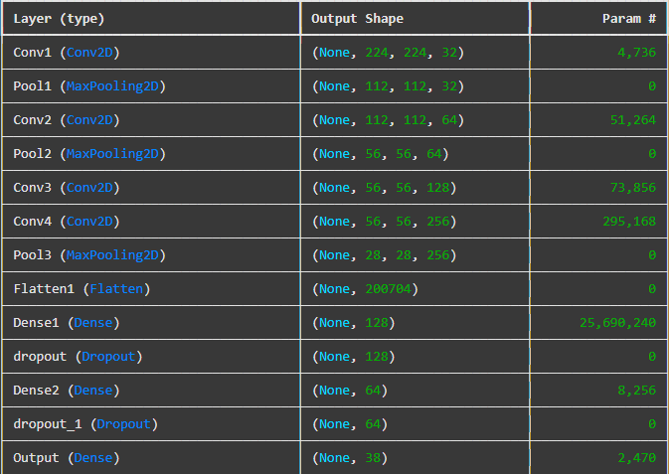

Week 2: Building, Training, Optimizing and Evaluating CNN Model

Slide 6
Summary
The plant disease detection project successfully developed a CNN model capable of accurately classifying leaf images into healthy and diseased categories for plants.
The model showcases the potential of deep learning to aid in early disease detection, promoting efficient agricultural practices.
The model showed strong performance during both training and testing, demonstrating its ability to generalize well to new data.

Slide 7
Future Scope
Covering more diseases: Future improvements could include expanding the dataset to cover a broader range of diseases, refining the model architecture for higher accuracy, and integrating the model into real-world agricultural systems for practical use.
Disease-specific Recommendations : After detecting the plant disease, recommend appropriate pesticides, or fertilizers. Provide dosage and application guidelines based on plant type.

Slide 8
References
Source of the dataset used in the project. https://www.kaggle.com/datasets/vipoooool/new-plant-diseases-dataset/data?select=New+Plant+Diseases+Dataset%28Augmented%29
Python Documentation and Libraries:
Python Documentation
Pandas Documentation
NumPy Documentation
Scikit-Learn Documentation
Jupyter Notebooks Documentation
Citation for Software and Tools:
Python Software Foundation. Python Language Reference, version 3.12. Available at https://www.python.org/.

Slide 9
Thank You!

